Slide 1
Add your collection date details here

Slide 3
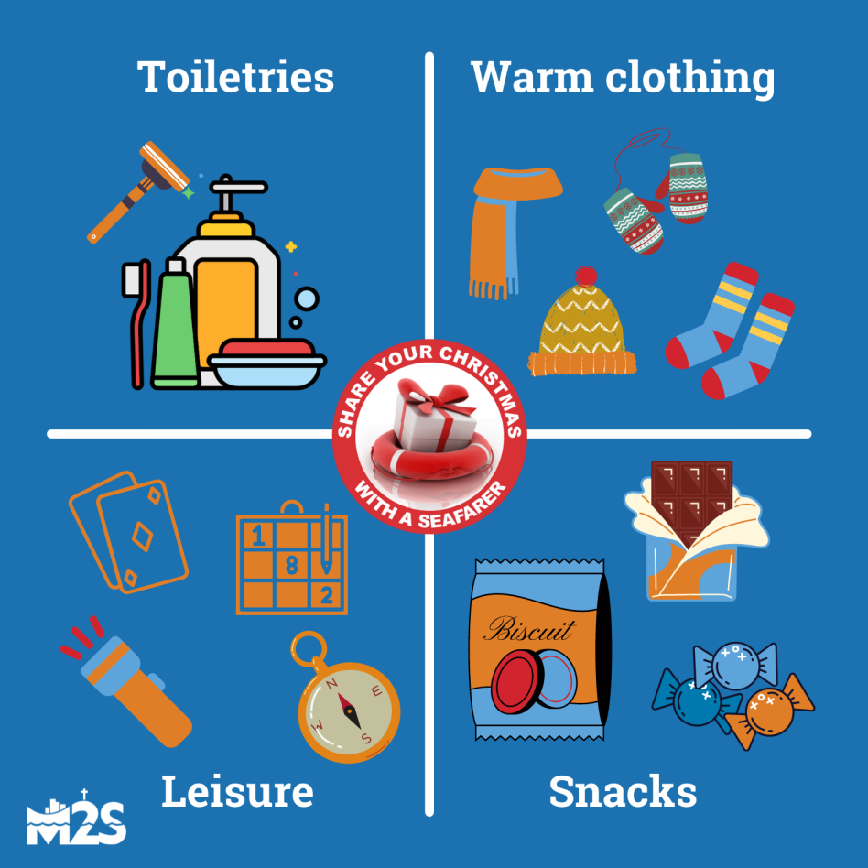
Pack a parcel. Return it by November 12th.
Details at www.ministrytoseafarers.org/parcels/#christmas-parcels
Christmas Parcel Campaign

